Slide 1
Weaving code extensions into Javascript
Benjamin Lerner, Herman Venter, and Dan Grossman
University of Washington, Microsoft Research

Slide 2
How do web pages run?
Web pages =
  HTML (structure)
  CSS (style)
  JS (behavior)
Extensions =
  New JS inserted into the page
<html>
...
<body>
<script>
function msg() {
return "Salutations";
}
body.onclick = "alert(msg());";
</script>
...
<script>
function msg() { return "hi"; }
</script>
</body>
</html>
Notes:
This is a talk about enabling third-party extensions to web pages and web browsers

Slide 3
Outline
Motivation
  Userscripts
  Browser extensions
Techniques and semantic flaws
  Wrapping
  Monkey-patching
Language approach: weaving mechanism
  Functions

Slide 4
Outline
Motivation
  Userscripts
  Browser extensions
Techniques and semantic flaws
  Wrapping
  Monkey-patching
Language approach: weaving mechanism
  Functions

Slide 5
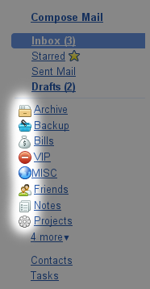
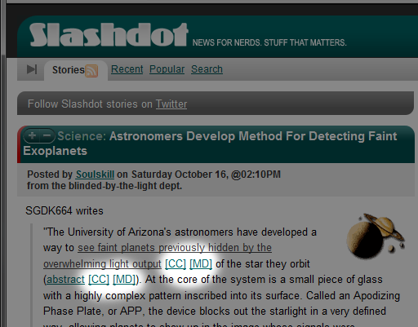
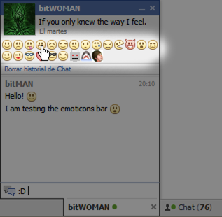
Motivation: Userscripts
Lightweight extensions to individual web pages
Add or change features of the site in ways the site designer never anticipated

Slide 6
Key features of Userscripts
Execution
  Userscripts are appended to the page
  Once added, they behave identically to page scripts
Popularity
  60K scripts
  10M+ users

Slide 7
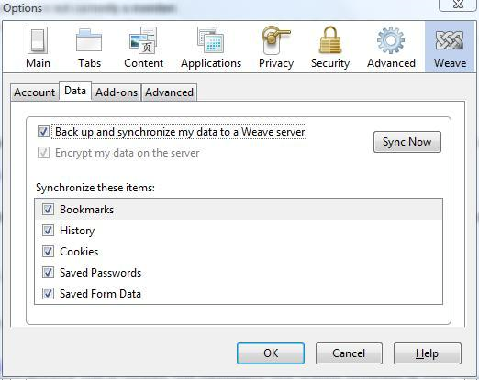
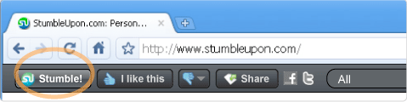
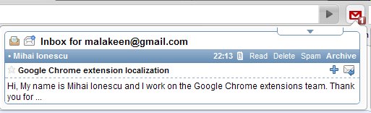
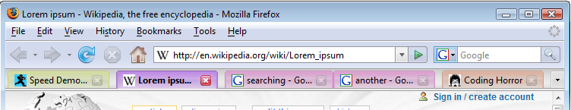
Motivation: Web-browser Extensions
Downloadable code that customizes a browser
Notes:
Web developers really like the separation of content, style, and execution, and users really like the extensibility it provides. This model is so popular that browsers, in particular Firefox but to varying degrees other browsers too, have defined their own UIs in terms of HTML-like content and JS execution, and that in turn brings extensibility to the browser UI.

Slide 8
How do these extensions work?
Can’t only append new code to the page
  It won’t get called
Need to replace existing code too
Only two techniques available within JS:
  Wrapping
  Monkey patching

Slide 9
Wrapping
“This function doesn’t quite do what I want; let me replace it”
How?
function P(iframe, data) {
...
}
function P(iframe, data) {
if (data[0] == "mb")
data[1] = format(data[1]);
...
}
var oldP = window.P;
window.P = function(iframe, data) {
if (data[0] == "mb")
data[1] = format(data[1]);
return oldP.apply(iframe, arguments);
}

Slide 10
Monkey patching
“This function doesn’t quite do what I want; let me tweak it”
Create a new closure and bind to existing name
A closure’s toString() returns its source code
eval("foo = " +
foo.toString()
.replace("some code",
"modified code"));
A closure
String-level search & replace

Slide 11
Monkey patching “idioms”
function XULBrowserWindow.setOverLink(link) {
...
}
eval("XULBrowserWindow.setOverLink = " +
XULBrowserWindow.setOverLink.toString().replace(/{/,
"$& link = Fission.setOverLink(link);"));
Idiom: $& inserts whatever was matched
Idiom: the first { is always the start of the function
When does this code run?
What is link?
function XULBrowserWindow.setOverLink(link) {
link = Fission.setOverLink(link);
...
}
Notes:
Well, this ‘works’, but let’s remind ourselves, as PL researchers, why this should feel grossly wrong…

Slide 12
Drawbacks of these approaches
Incorrect for aliases
  All other aliases are unmodified
function foo(x) { return x*x; }
var bar = foo;
eval("foo = " + foo.toString().replace("x*x", "42"));
> foo(5) == bar(5);
> false

Slide 13
So, don’t alias functions…?
Function aliases are everywhere in web JS code
  Installing event handlers creates aliases
Needs a solution that works with existing web code
function onLoad(evt) { window.alert("hello"); }
window.addEventListener("load", onLoad, ...);
eval("onLoad = " + onLoad.toString.replace('hello', 'hi there'));
> ...loading the page...
> Alert: “hello”

Slide 14
Drawbacks of these approaches
Incorrect for closures
  They are new closures that have the wrong environment
function makeAdder(x) { return function(y){ return x+y; }; }
var addFive = makeAdder(5);
eval("addFive = " + addFive.toString.replace('y', 'z'));
> addFive(3)
> error: ‘x’ is undefined

Slide 15
Outline
Motivation
  Userscripts
  Browser extensions
Techniques and semantic flaws
  Wrapping
  Monkey-patching
Language approach: weaving mechanism
  Functions

Slide 16
Goal: combine extensions & mainline
Extensions need to:
  Define what new code to run
  When it needs to run
  How it interacts with existing code
Sounds a lot like dynamic aspect weaving!
  …Unless you’d rather we not call it “aspects”
  These aren’t traditional “cross-cutting concerns”
We use the same mechanism, not the same motivation
Notes:
We are going to define new JS language primitives aimed squarely at the needs of extension authors. That may not seem much like AspectJ, and that’s fine.

Slide 17
Aspects
Aspects = Advice + Pointcuts
Advice defines what new code to run
Pointcuts define when to trigger it
Pointcut
Type of advice
at pointcut(callee(square)) before (x) {
print("x is ", x);
}
callee(square)
before
(x)
print("x is ", x);
Arguments to function
Advice

Slide 18
Key features of our aspects
at pointcut(callee(square)) before (x) {
print("x is ", x);
}
callee(square)
print("x is ", x);
square
env
code _
+ advice
aliasToSquare
This cannot be done in JS

Slide 19
Kinds of aspects
Function advice:
  Before, around, after calls to functions
  Before, around, after bodies of functions
Field advice:
  Around getting, setting fields
Statement advice:
  Before, after, around statements within functions
…others?

Slide 20
Implementation: function advice
Targeting a JIT compiler
Key idea:
weaving = inlining advice + invalidating JITed closure
Inlining advice:
  Avoids function-call overhead
  Ensures advice has access to local variables
Invalidating JITed closure:
  Ensures next calls to function get the advice
  Amortizes weaving cost across all calls to function

Slide 21
Conclusions
Extensions have strange behavior
  Existing techniques within JS are inadequate
  But we can’t simply outlaw all extensions
Introduced dynamic aspect weaving as new JS language feature
  Provides cleaner semantics
  Provides better performance
  Provides sufficient expressive power for real extensions
  Win-win!

